Slide 1
Utah
Coordinated Resource Management
Planning

Slide 2
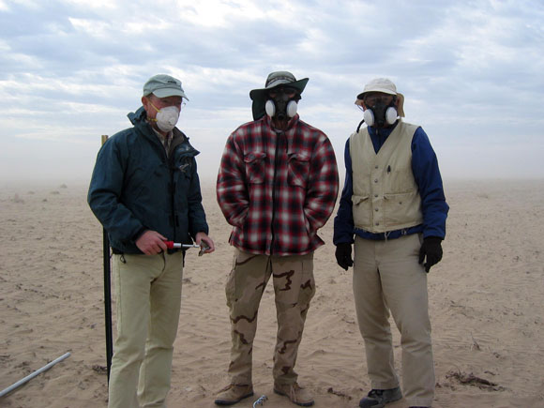
SO – What is CRM ?
Milford Flat Fire Area
Stakeholder consensus decision-making process. Stakeholders are any interest with a stake in the consequences of the decision. The stakeholders make decisions by consensus, rather than by traditional voting and majority rule.
Consensus, as defined by various CRM practitioners, means, "The group makes decisions collaboratively. There is no voting, and everyone can live with the decision--discussion continues until they can. Although all participants may not agree 100% with all aspects of the decision, all participants support the whole decision 100%."

Slide 3

CRM
Key Principles
Initiation of planning by locals who recognize the need;
Direct communication among participants;
Inclusion of all interests and ownerships;
Consideration of resource functions, values, and uses;
Respect of rights, viewpoints, and obligations of all
participants;
Recognition of existing laws and regulations;
Decision-making based on consensus

Slide 4
CRMP - Guidelines
Voluntary participation by all partners in the process
Landowner initiated; others are essential in the process, but landowner commitment is critical for success in natural resources management
Involvement by all players; those without ownership in the process will create roadblocks
Experienced, neutral facilitators are key to forming the teams and training participants in the process so the participants learn to balance power, focus discussions on goals and interests, etc.; facilitators can step back in to help the group get past stumbling blocks, should they occur
Establish ground rules early by group consensus, to set the group's behavioral norms
Determine common goals early by group consensus; stay focused on those goals
Be sure participants have decision-making authority for their constituencies

Slide 5
CRMP - Guidelines
Talk about "needs" rather than "positions;" say "I need" instead of "you can't"
Create a team to develop empowering trust and respect
Be committed to the process and to the rest of the team; it takes time and hard work to develop consensus decisions. Build a sense of accomplishment and progress; start with small accomplishments, especially in contentious situations
Develop management objectives and action plans which move toward the goal(s)
Monitor, monitor, monitor to measure progress and develop long-term trend data about the resource; monitor the process, as well, to be sure the group is accomplishing its goals
Make the plan flexible to allow for unforeseen circumstances, yet rigid enough to provide for accountability
Make all decisions by consensus to balance power, prevent logrolling, develop trust, and ensure that all interests are supportive of each decision

Slide 6
Coordinated Resource Management Planning
MOU & Handbook
(Update underway)
MOU PURPOSE:
Facilitate on-the-ground results.
Promote the exchange of ideas and Mgt strategies to address local issues.
Foster communications, cooperation and coordination in developing and implementing sound resource management and conservation programs where mutual concerns are identified.

Slide 7
Most
Coordinated Resource Management
Advisory Committees
Informed Consent
Pre-Plan
Public Mtgs
Decision Input
Post-Plan
Public Mtgs
Must operate at the top scale….otherwise not using the CRM process
Public
Notice
Least
Secrecy

Slide 8

CRM is more SOCIAL than Technical
Challenge = getting adversaries to listen and understand one another’s needs

Slide 9
Some Example CRMPs………
Chalk Creek – Summit Co.
Little Bear River – Cache Co.
Otter Creek – Piute Co.
Deep Creek – Tooele Co.
Clover Creek – Tooele Co.
Spanish Fork – Utah Co.

Slide 10
Stumbling Blocks…..
Loss of focus -more issues /than plan can address
Us (vs) Them
Fuzzy Agendas – no purpose
Unclear responsibilities – outline clear expectations
Falling behind schedule
Not taking plan far enough
Difficulty pulling plan together – (use a guide)

Slide 11
Utah CRM Memorandum of Understanding (Update 1989 ver)
Policy: Signatory parties agree to cooperate in developing & applying CRM principles…..for interdependent lands.

Slide 12
Utah CRM Memorandum of Understanding (Update 1989 ver)
Authority: Fed Agencies = National MOU w/USFS/BLM, NRCS, Extension Service (1987)
  State: covered by existing Fed/State statutes or delegations of authority

Slide 13
CRM in Utah
Future/Direction
Next Steps ??
Meet with MOU signatories- Discuss future of CRM in Utah – Commitments – Training ??
Review Leadership / Organization – State Level
Review Organization - Local Level

Slide 14
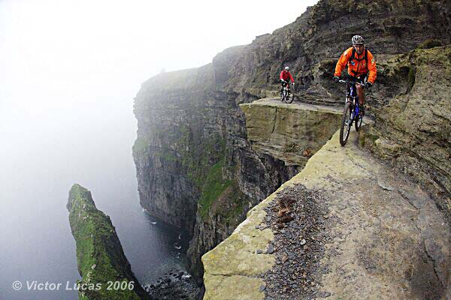
This is the END.…..

